Slide 1
The right to privacy and everyday technologies
Laura REED
Research Analyst, Freedom on the Net
Freedom House
freedomhouse.org
reed@freedomhouse.org
@lauraannreed

Slide 2
Freedom on the Net 2014
Freedom House is an independent watchdog organization dedicated to the advancement of freedom worldwide.
Freedom on the Net 2014: available online at freedomhouse.org

Slide 3
How has the basic character of privacy changed due to modern technologies and social networks?
More information – and more types of information -- can be accessed and used by third parties.
Data can be accessed by a wider array of actors (national governments, foreign governments, international tech companies, others).
New frameworks needed for understanding and applying the right to privacy to the online sphere.

Slide 4
GLOBAL THREATS TO PRIVACY: Governments
Arrests for online communications were documented in 38 of the 65 countries, with social-media users identified as one of the main targets of government repression.
Of the 65 countries we examined, 19 passed new laws expanding surveillance or restricting user anonymity since May 2013.
Emerging threat: data localization laws

Slide 5
GLOBAL RIGHT TO PRIVACY: International tech companies
What is the role of international tech companies in protecting the right to privacy?
How can international tech companies, such as Google and others, mitigate privacy concerns of their users that may vary widely from one jurisdiction to the next?
Taking into account privacy concerns when creating apps
May 2013 ECJ decision: “right to be forgotten”

Slide 6
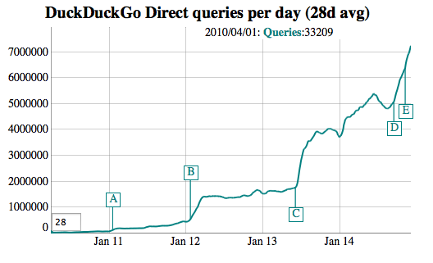
PROMOTING PRIVACY AND SECURITY TOOLS
Use of PGP (email encryption tool) nearly tripled from June to August 2013
Tor connections have doubled since June 2013
Duck Duck Go (search engine without tracking) saw 50% more traffic immediately after NSA revelations
Beginning of NSA surveillance leaks

Slide 7
The right to privacy and everyday technologies
Laura REED
Research Analyst, Freedom on the Net
Freedom House
freedomhouse.org
reed@freedomhouse.org
@lauraannreed

