Slide 1
Isurid: Tõde ja Õigus Izhorians: Truth and Justice Tallinn 10/12/2014

Slide 2
Izhorians in Leningrad region
Soikkola – last place of compact settlement
Appr. 300
Finno-Ugric people
1164 – 1st official record
1926-1937 national municipality and education

Slide 3
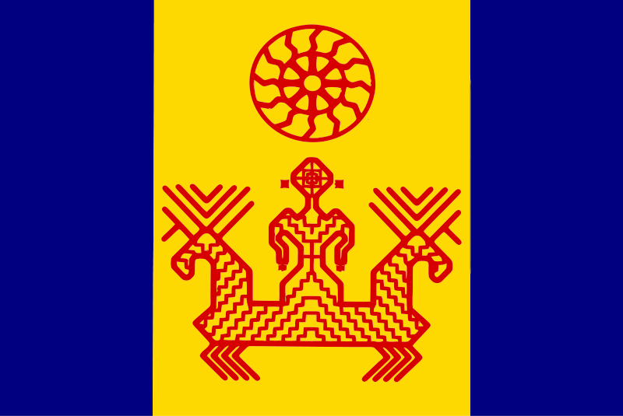
Growth of National Self-Identity 2000-2014
Indigenous People Law 1999 (№82-FZ)
Unified List of small numbered indigenous people of RF (2000)
Establishment of national NGO
National symbols
Summer fests
Recreation of language classes
Museum
Folk ensembles
Newspapers, Internet, Educational materials
Cooperation with NGOs
Involvement of young generation

Slide 4
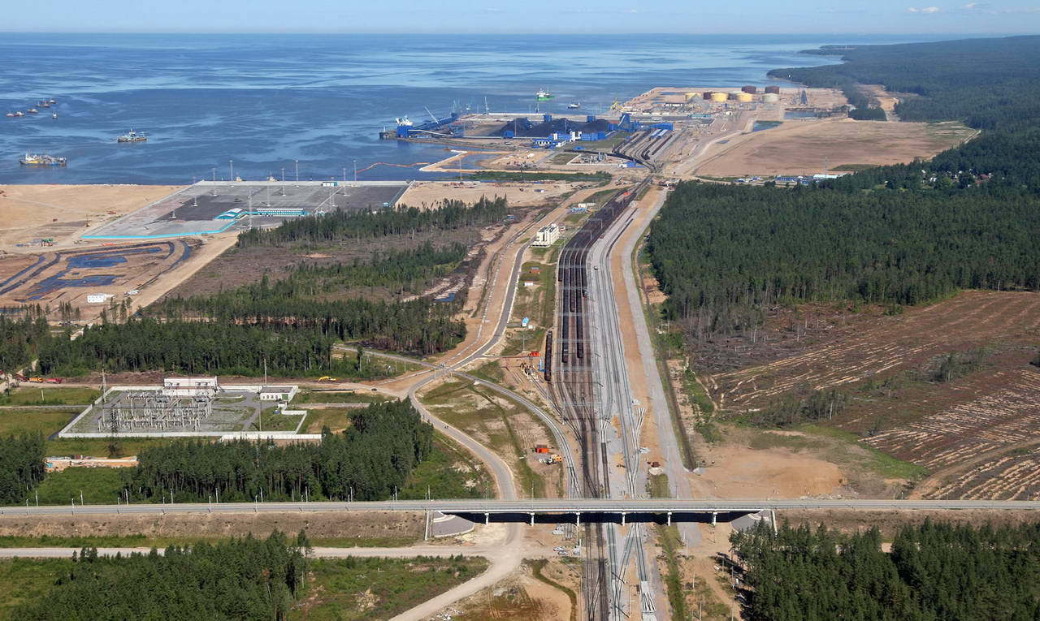
Last traditional occupation area – zone for intensive industrial expansion

Slide 5
Current situation
Closest forecasts
Ust-Luga Sea Port volumes 2013 = 62,7 MMt (http://www.morport.com/rus/news/document1487.shtml)
Oil, sulphur, coal, general and liquid cargo, etc.
Limited access Gulf of Finland
Extraction of timber/ hazardous wastes dumping
Performance of «compensation measures»
Liquefied hydrocarbon & gas condensate terminals
Metallurgy terminal at raised territory
Industrial Zone «Ust-Lugа»
Baltic Carbomide Plant, LLC
Multimodal complex UstLuga, LLC (www.ust-luga-mmc.ru)
«North-West Sea port»
«Aurora» OJSC terminals
Extraction activity
Cargo airport

Slide 6
New start point in “Izhorian case”
July 2013 opposition of Votian indigenous people to construction of next plant close to Luuditsa (Luzhitsy)
January 2014 opposition of local people and NGOs to carbomide plant (Soikkola peninsula)
2014 generation of common position and action plan: regardless of nationality
Information distribution: public, authorities, NGOs, Finno-Ugric world

Slide 7
http://www.greenworld.org.ru

Slide 8
Reason of protest
Alternative areas exist
Irreparable harm: ecosystem and habitat
Increasing anthropogenic and development pressure
High concentration of 1st class hazard industry
Destruction of objects for archeological research and nature/cult objects
Loss of traditional environment and national values

Slide 9
To build a dialogue
Independent study and recommendations by cultural and scientific institutions
Written proposals to Governor
Letters to government agencies
Proposals to Territory Development Master plan
Ready for dialogue

Slide 10
What people are voting for:
Sea port development only within territories already occupied for terminals
Area for recreation and tourism
Agriculture, farming and fishing
Natural ethno-cultural protected area
“Soikkola” Sanctuary as a dominant instead of industrial zone
Official status of territory as traditional

Slide 11
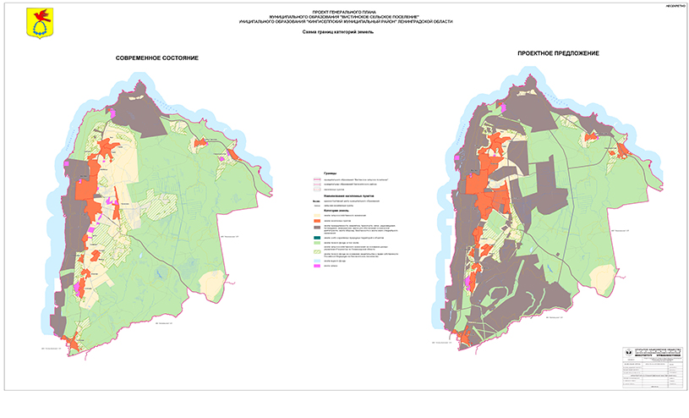
Master plan for development 2015-2035

Slide 12
Civil society tools: Public hearings 28/11/2014
Violation of civil rights
Drafting Master plan based on irrelevant data
No rational proposals
1st - Industry; 2nd – health and social development
Master plan propaganda campaign (what to do with “dangerous persons”?)
Misinformation of local people
Demand to re-design Master plan

Slide 13
“Information bulletin of Civil initiative” anonymous newspaper 1 page Propaganda of industrialization and United Russia party 2 page Struggle against dissent (izhorians and activists) using dirty tricks

Slide 14
Reaction
administration/investor
people
Do they exist? Object &Subject of Legal protection
Aggression: “internal enemy”
Task to politicize the issue
Hiding actual plans
Regional support programs
Protection of rights = common civic position. No politics
Natural environment as National heritage and value; People as heritage of the State
No natural environment = No Nation
To avoid provocation of extremism
1937-1955 - «returning»?
Do we have Law?

Slide 15
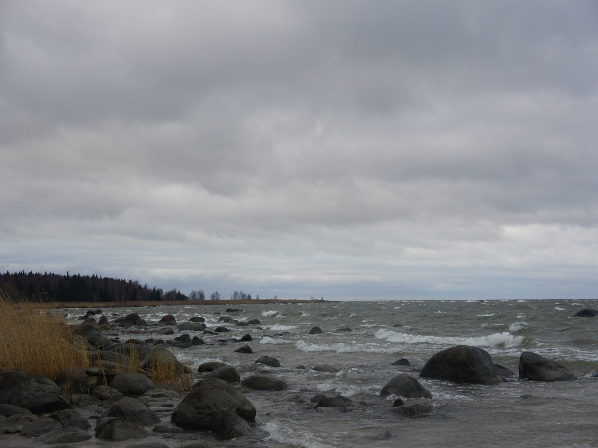
ŠUUR KIiDOŠ, PASSIBA Thank YOU СПАСИБО
SUUR AITÄH

