Slide 1
Annual Conference on Human Rights 2014: “Dignity in the context of human rights”
Mary O’Hagan
National Democratic Institute, Ukraine

Slide 2
Why are Ukrainians so determined to reform their political system?

Slide 3
What progress has been made so far? Successful elections Crimson Hexagon Search Term: Poroshenko 28.9-29.10.14 Russian and Ukrainian Language sources: Twitter, Facebook, Blogs

Slide 4
What Progress has been made so far? Reform-minded Parliament
Actual Results
Parties in Parliament: 11
Parties needed to form a majority: 3
Vacant seats: 27 (6%)
Percentage of women MPs: 11%
Percentage of self-nominated MPs: 23%
Party lists only
Parties in Parliament: 6
Parties needed to form a majority: 2
Vacant seats: 0 (0%)
Percentage of women MPs: 20%
Percentage of self-nominated MPs: 0%

Slide 5
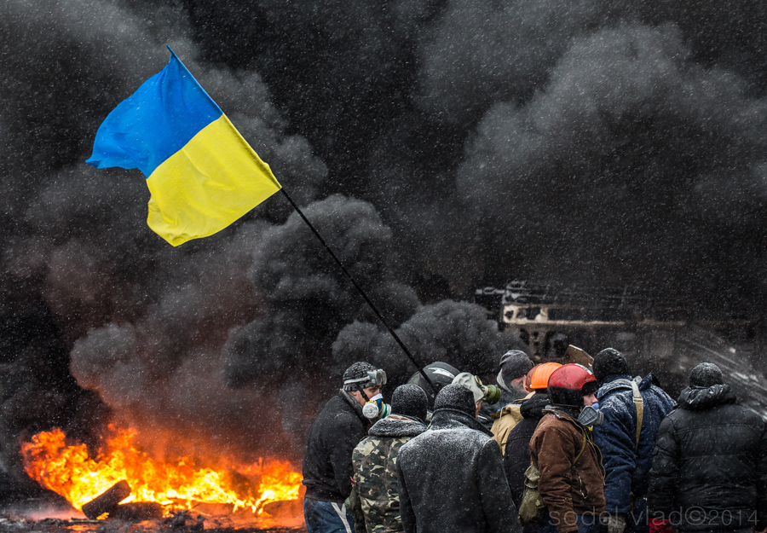
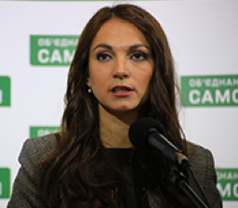
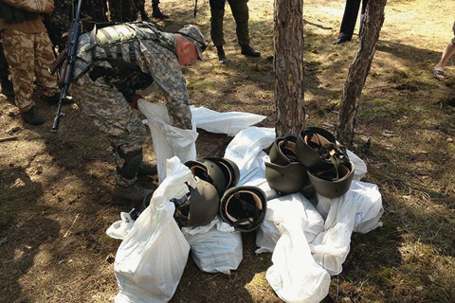
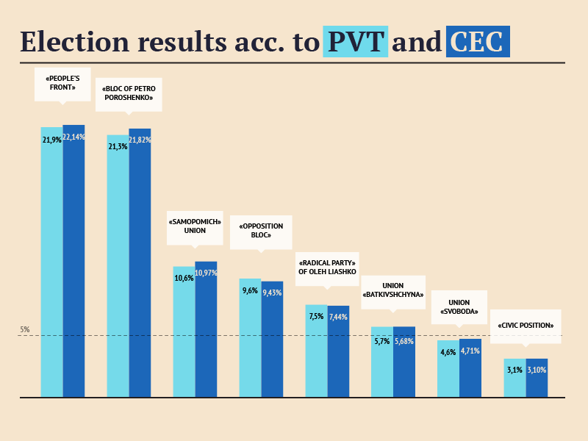
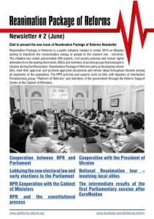
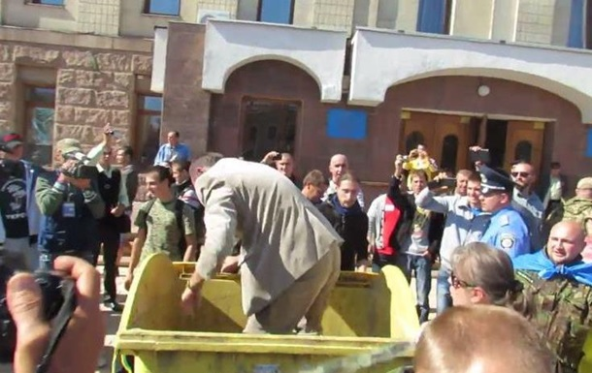
What progress has been made so far? Resurgent civil society

Slide 6
What needs to happen now? Inclusive discussion about reforms 2014 Parliamentary Elections: Turnout Map

Slide 7
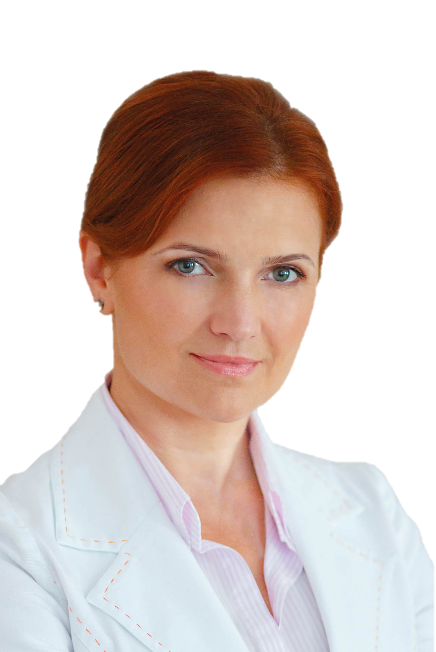
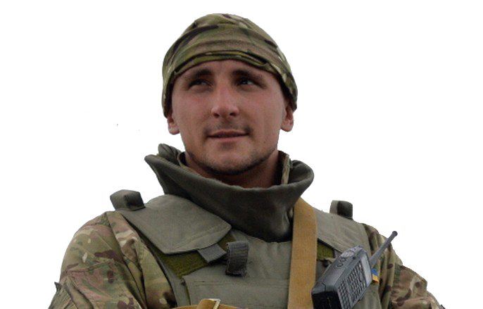
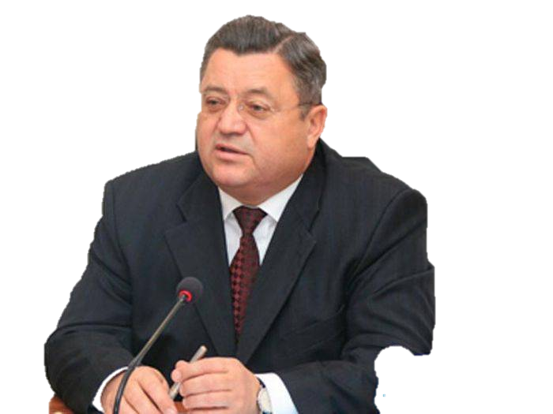
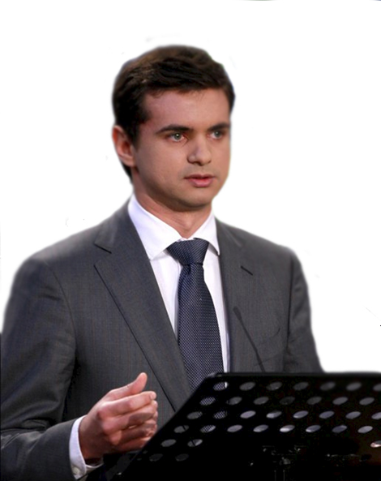
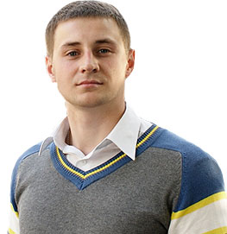
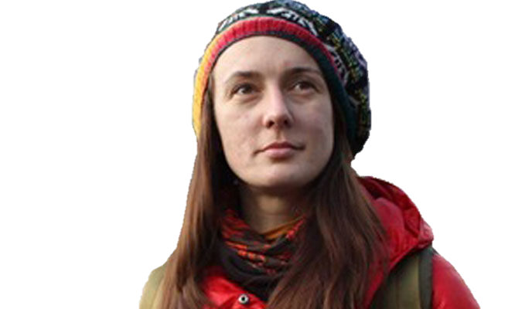
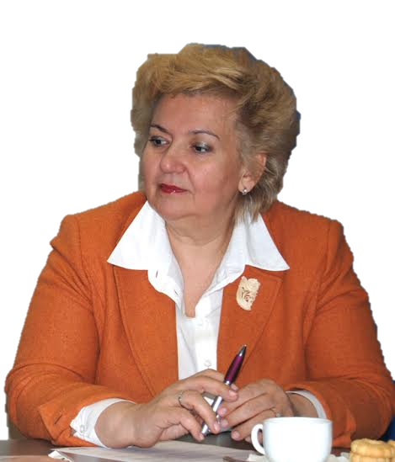
What needs to happen now? Emergence of new leaders

