Slide 1
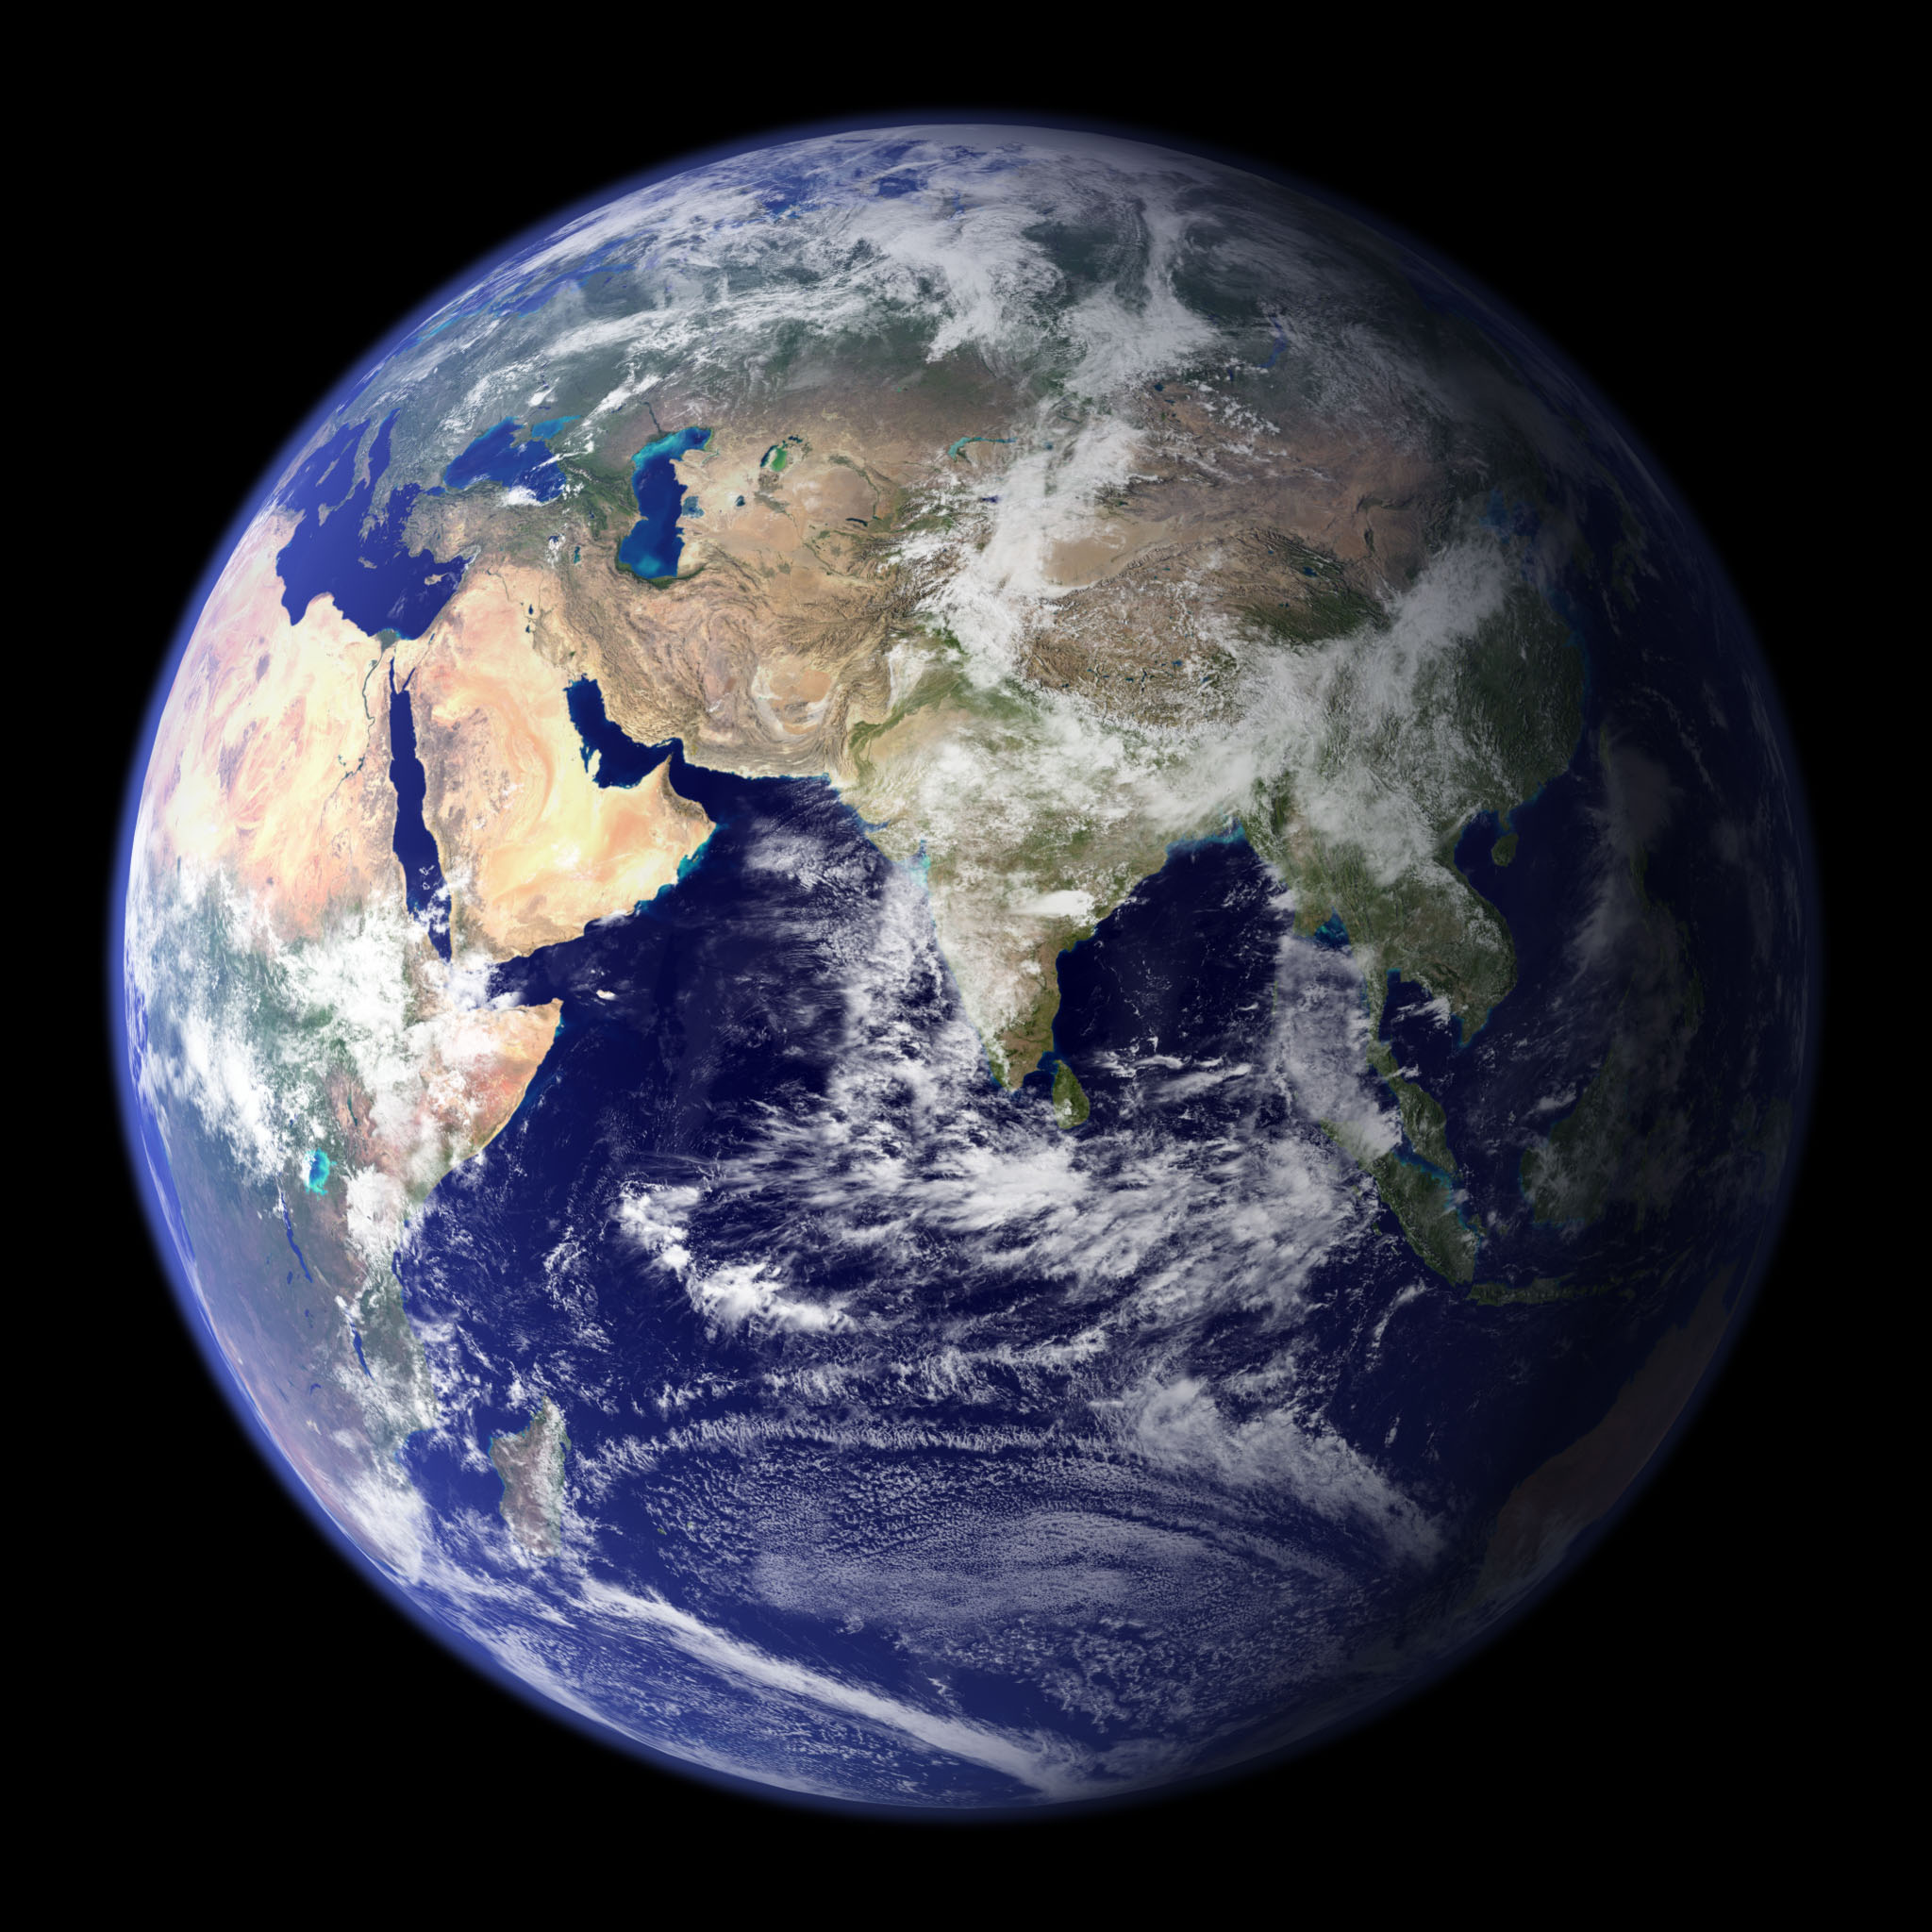

Slide 2
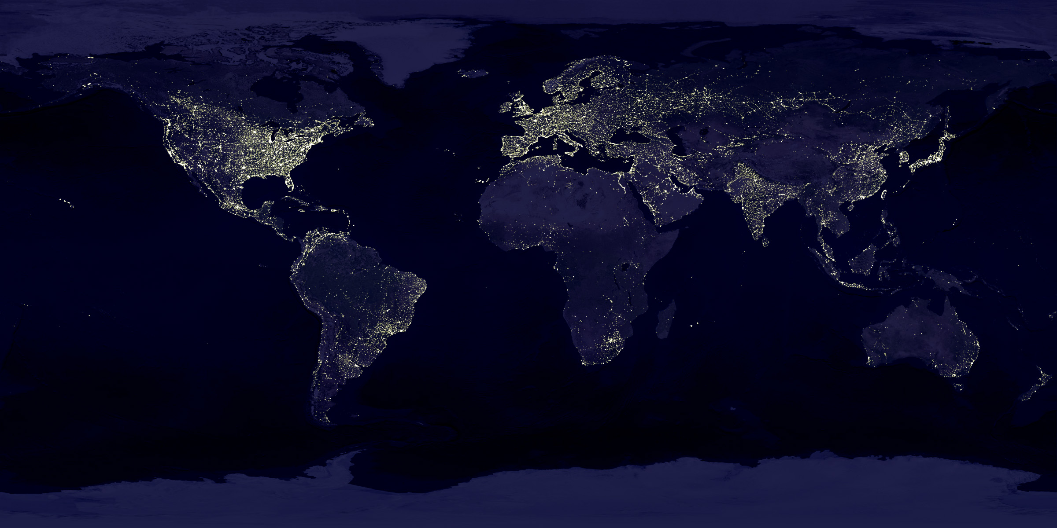

Slide 3
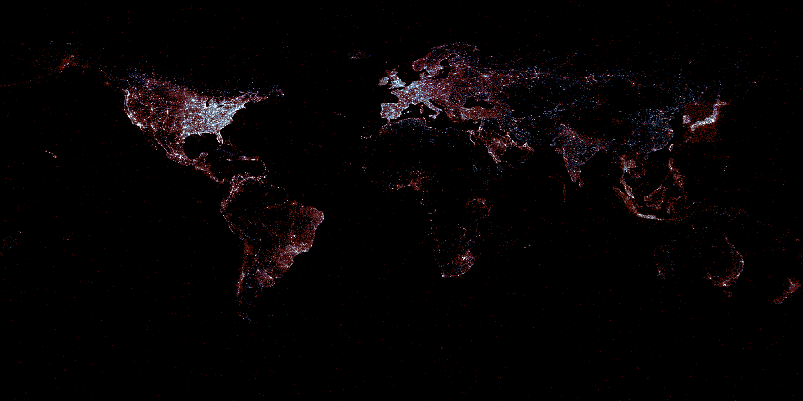

Slide 4
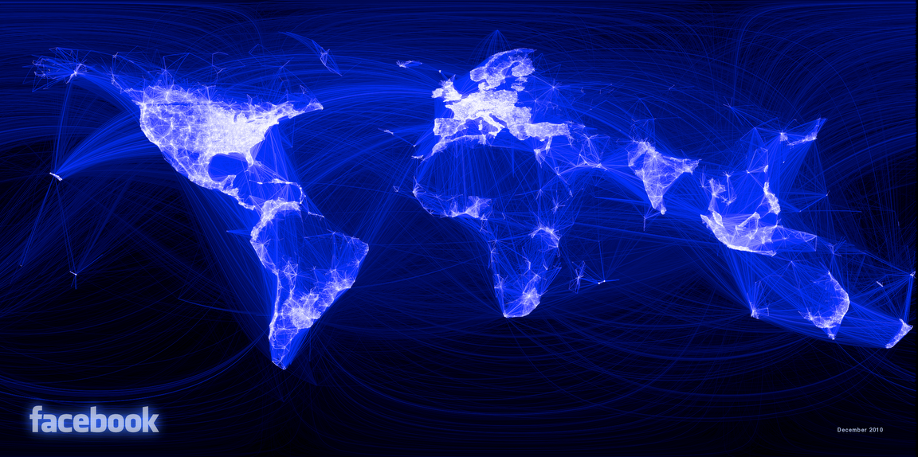

Slide 5
Our Digital World
1/3 global population online
As many cell phones as people on earth
Facebook alone has:
240 billion photographs (35% of all online photos)
1 billion members with 1 trillion connections
Notes:
Fast forward to today and we’ve reached an incredible point in human history.

Slide 6
Every Year
6.1 trillion text messages
2.2 trillion cell minutes in the US alone
107 trillion emails
1.6 million days worth of video uploaded to YouTube

Slide 7
Every Day
2.5 billion new items added to Facebook
300 million photos posted to Facebook
500TB of new data about society’s innermost thoughts posted to Facebook
As many words posted to Twitter every day as the entire New York Times in the last half-century
100 billion+ social media actions taken

Slide 8
Every Minute
600 new websites created
204 million emails sent
700,000 shares on Facebook
200,000 photos posted to Facebook
277,000 tweets sent

Slide 10
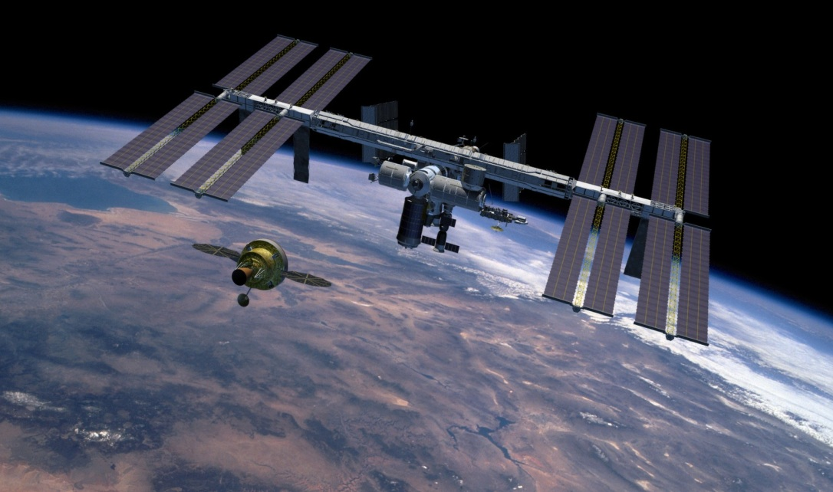

Slide 11
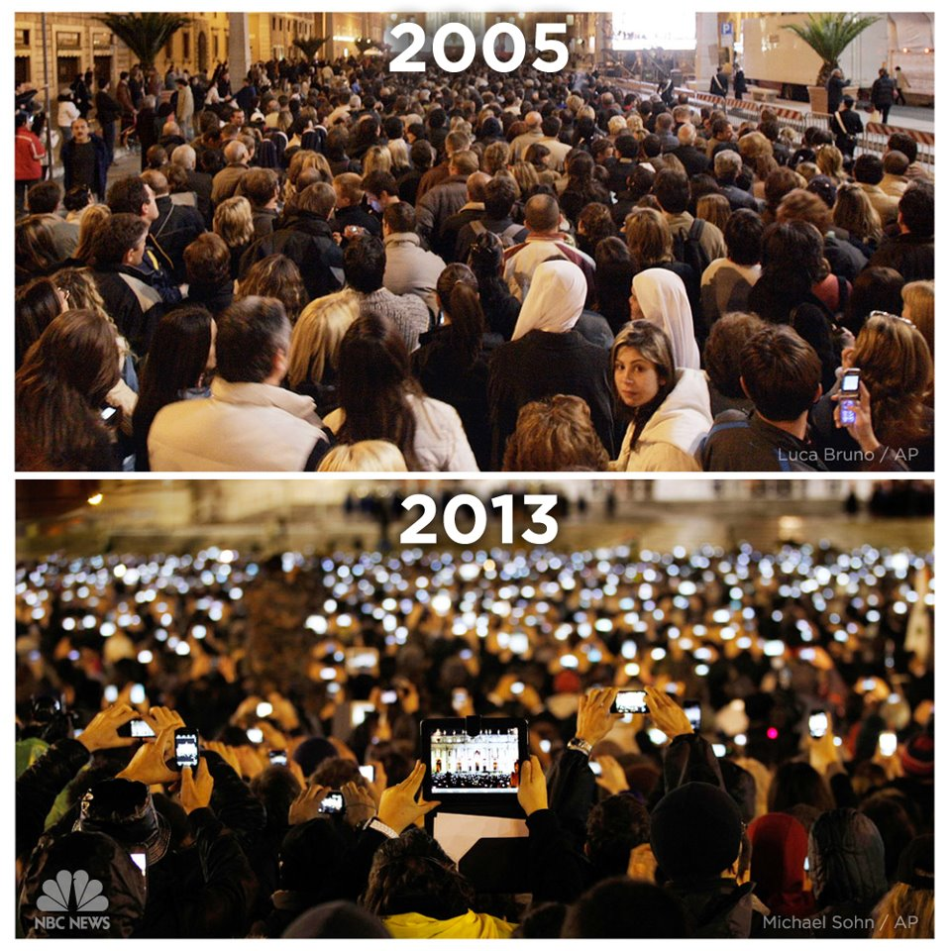

Slide 12
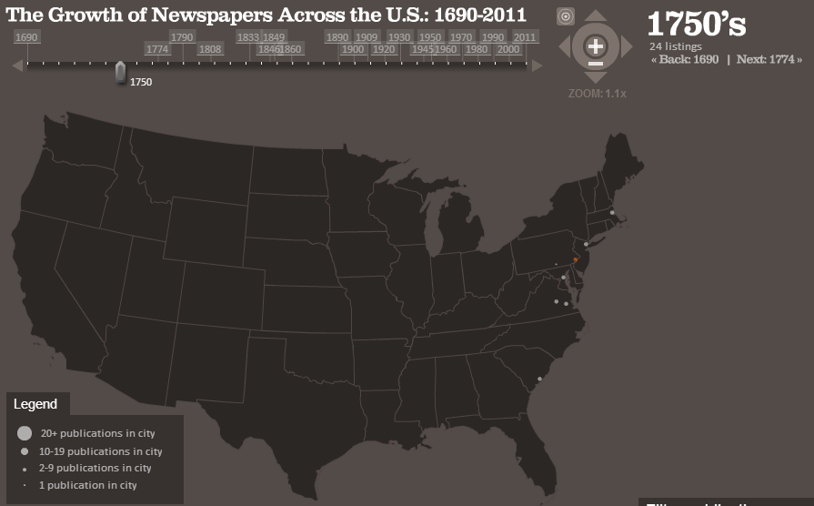
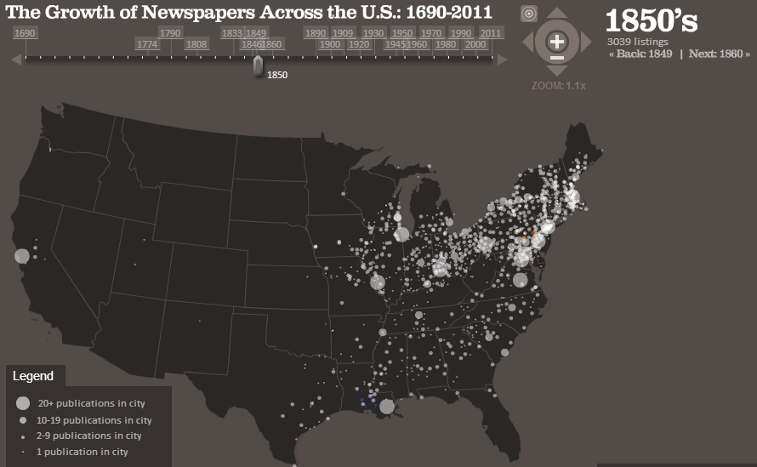
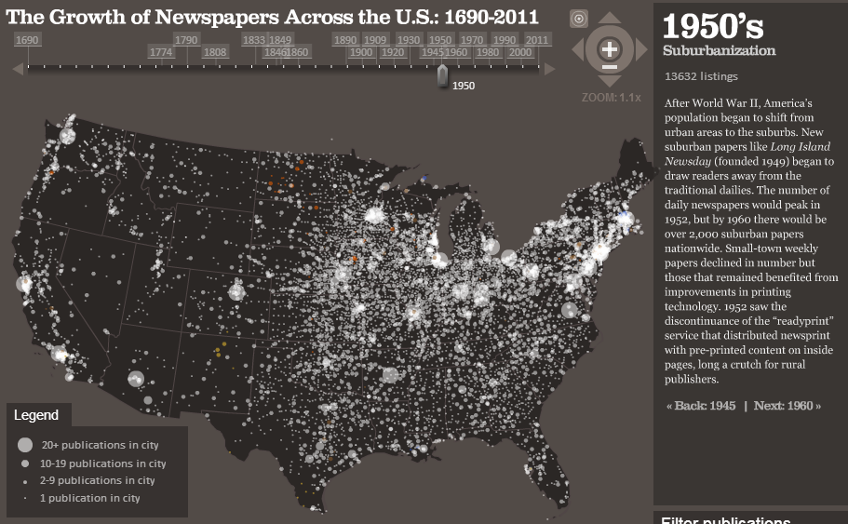
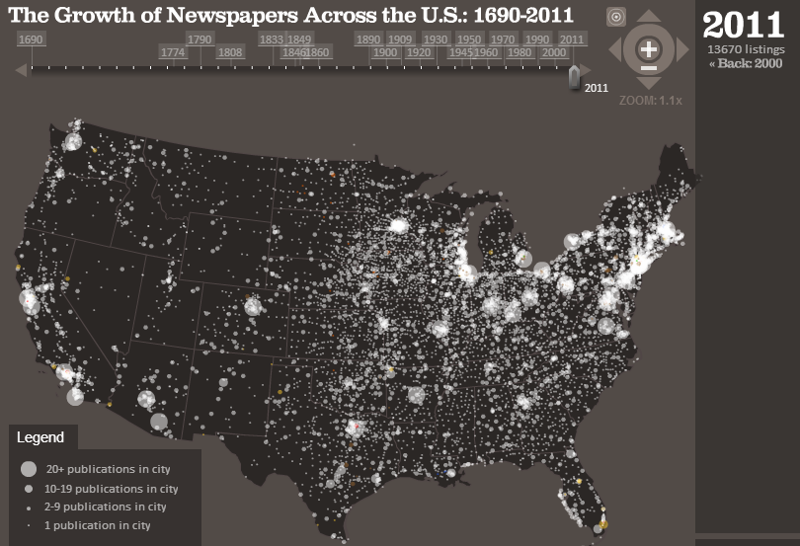

Slide 13
The Rise of Web News

Slide 14
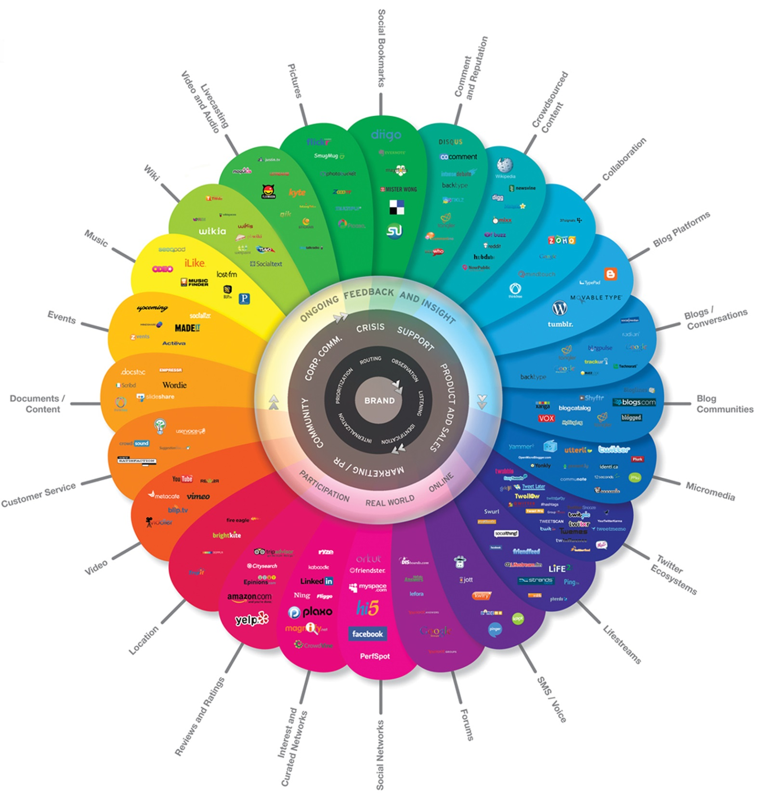

Slide 15
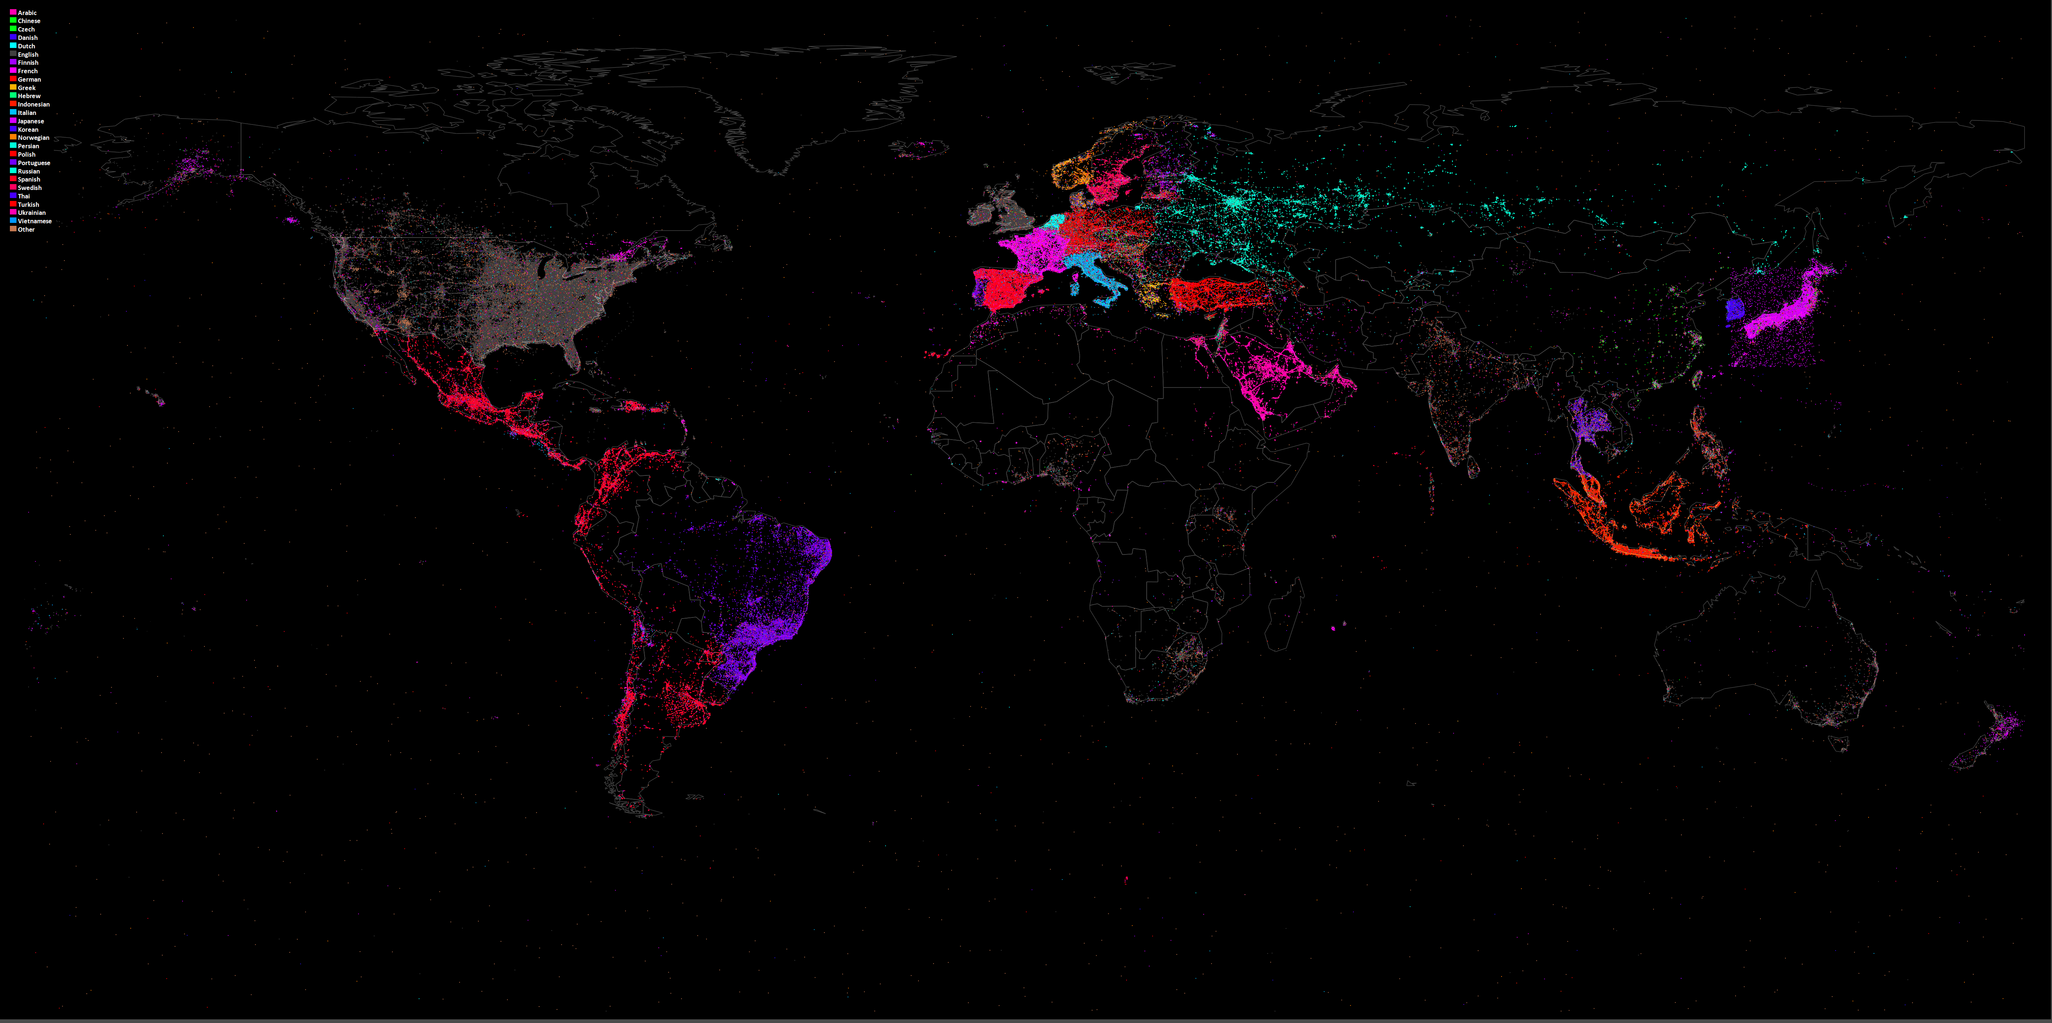

Slide 16
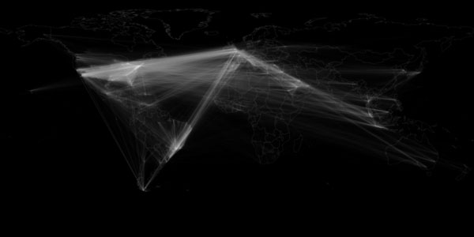
Network map showing locations of users retweeting other users (georeferenced Twitter Decahose tweets 23 October 2012 to 30 November 2012).

Slide 17
GDELT: “A Realtime Social Sciences Earth Observatory”
Goal: process all media worldwide into a single global catalog of behavior and beliefs in realtime
Team: Kalev Leetaru (Georgetown), Philip Schrodt (Parus Analytical Systems), Patrick Brandt (UTD)

Slide 18
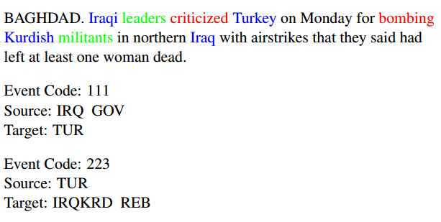
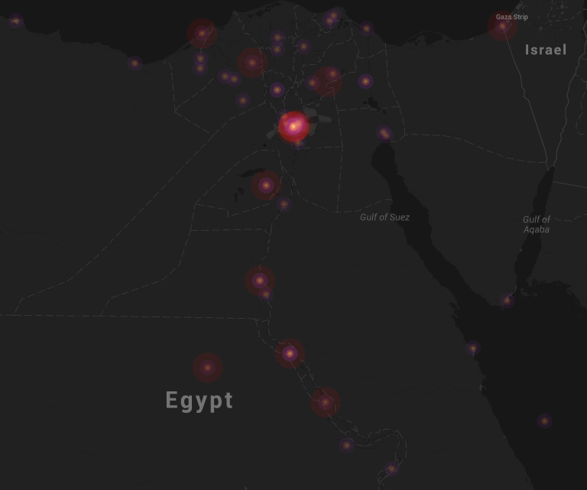

Slide 19
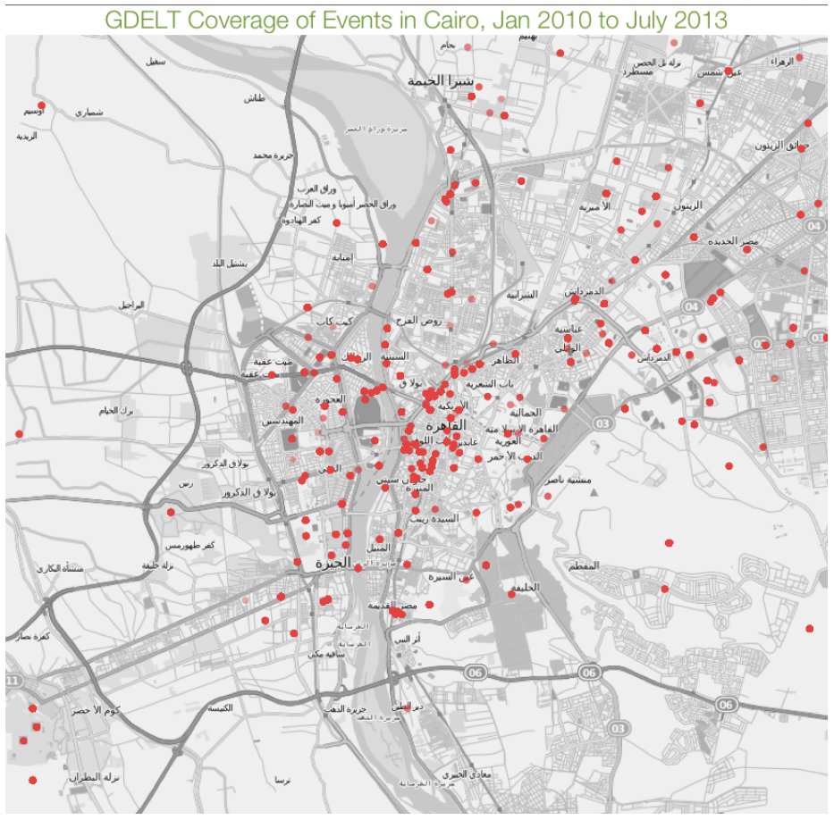

Slide 20
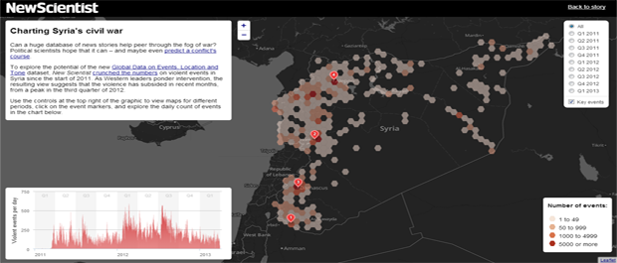
New Scientist Magazine - Syria

Slide 21
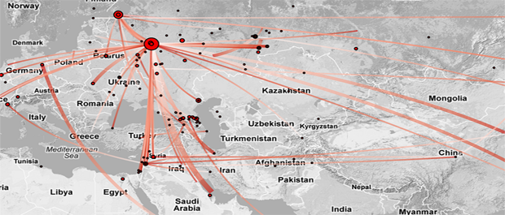
Rolf Fredheim – Russia Network

Slide 22
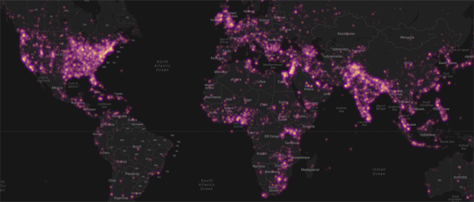
John Beieler – Global 2013 Protests

Slide 23
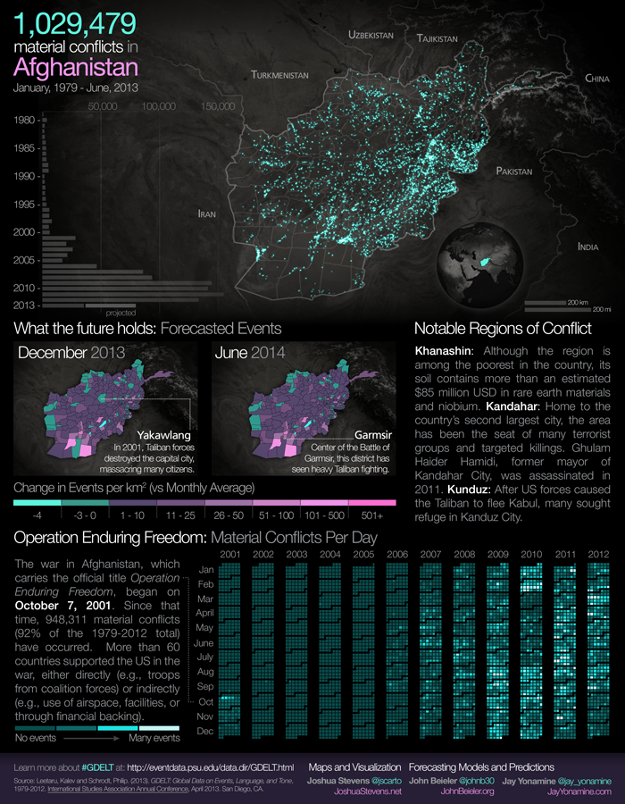

Slide 24
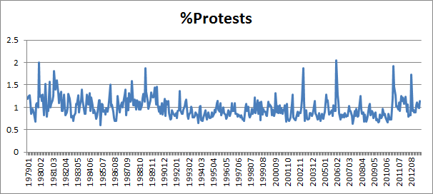
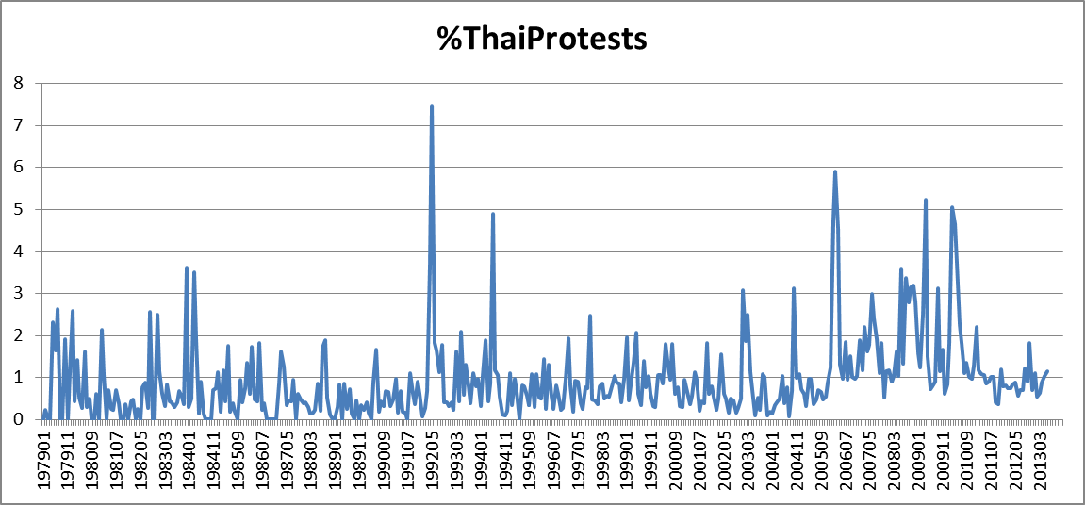
Interactive Data-Scale Exploration
Currently piloting Google’s Big Query database service with complete GDELT database.
Live interactive complex queries across all quarter-billion records return in just 1-6s.
Explore global patterns across quarter-century in realtime.

Slide 25
The GDELT Global Knowledge Graph (GKG)
Single global graph over the entire world connecting everything reported in the media each day:
People
Organizations
Locations
Themes
Emotions
CAMEO events
SET events (# killed/wounded/protesting/arrested/affected/kidnapped)
SET taxonomies (natural disasters/manmade disasters/religion/ethnicity/disease/*functional actors*)

Slide 26
Hosni Mubarak

Slide 27
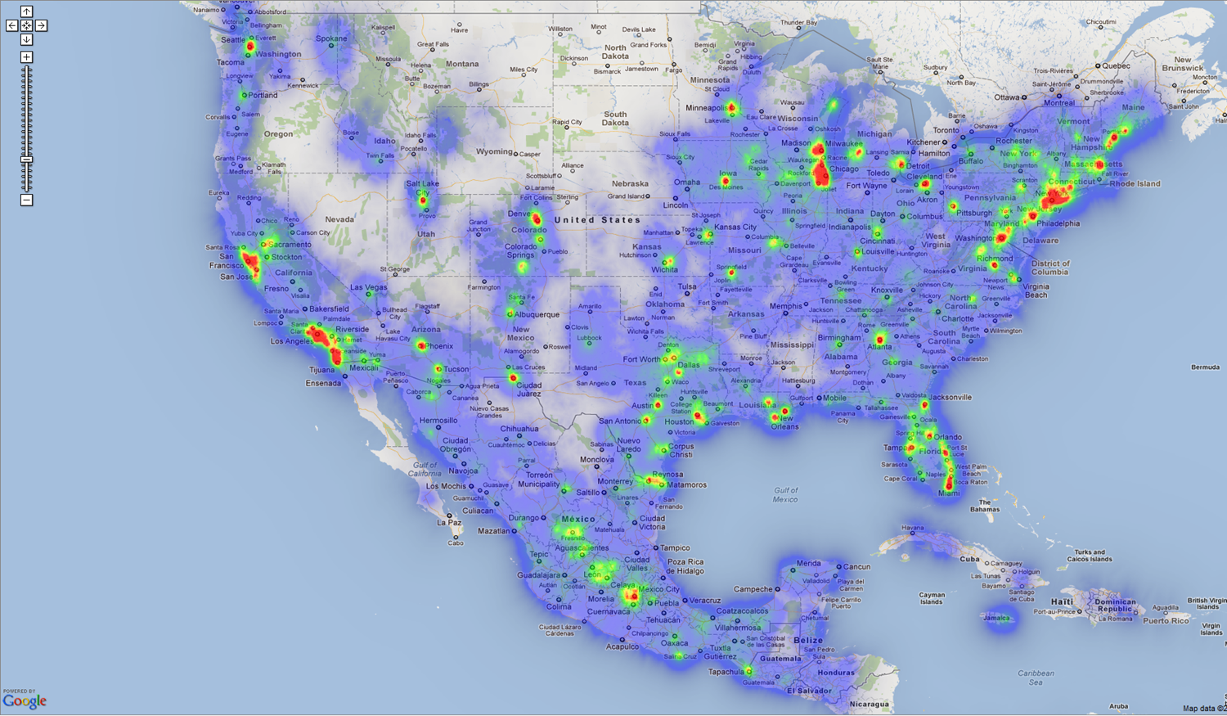
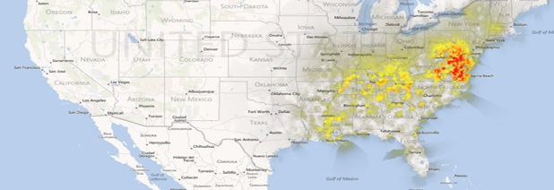

Slide 28
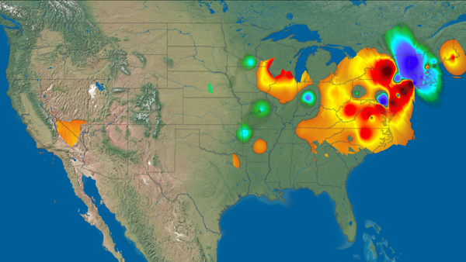
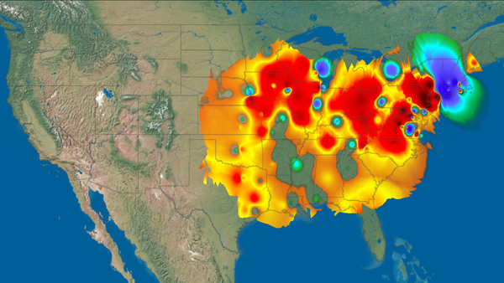
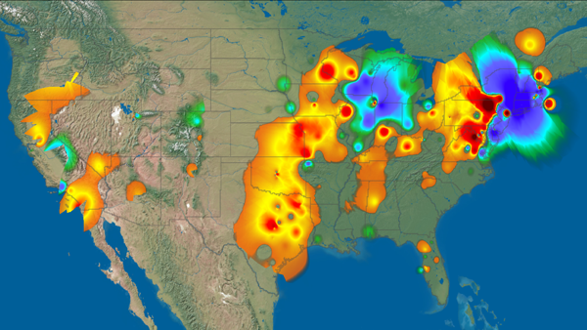
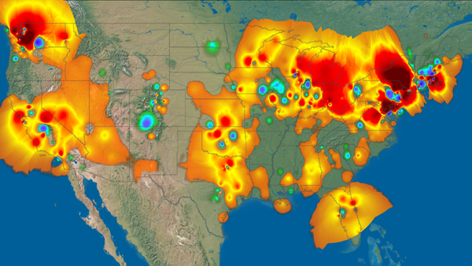

Slide 29
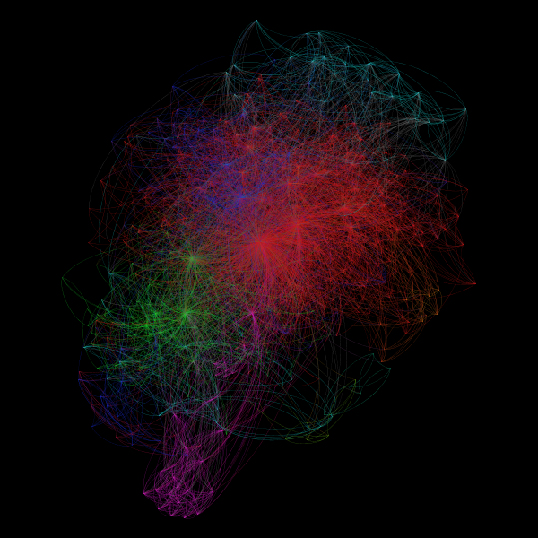

Slide 30
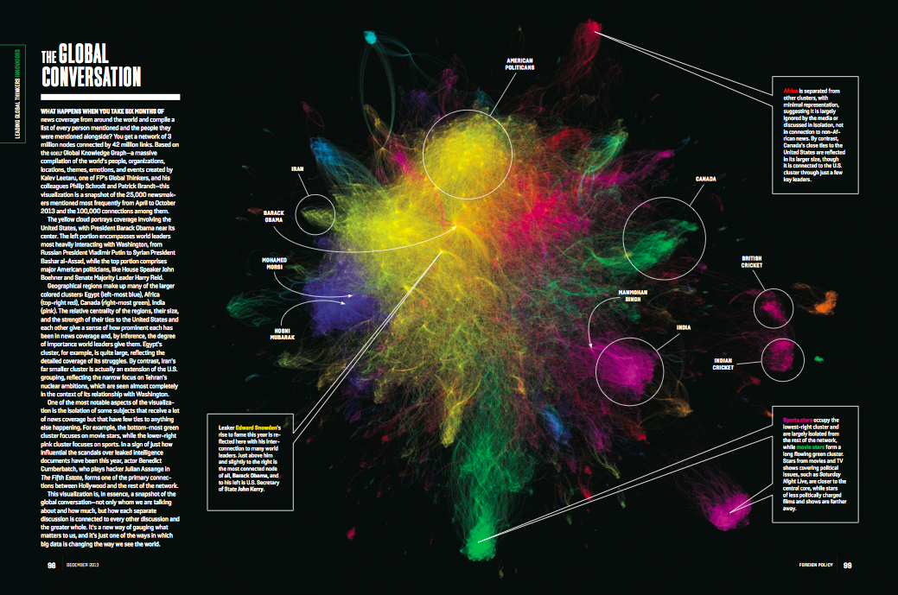

Slide 31
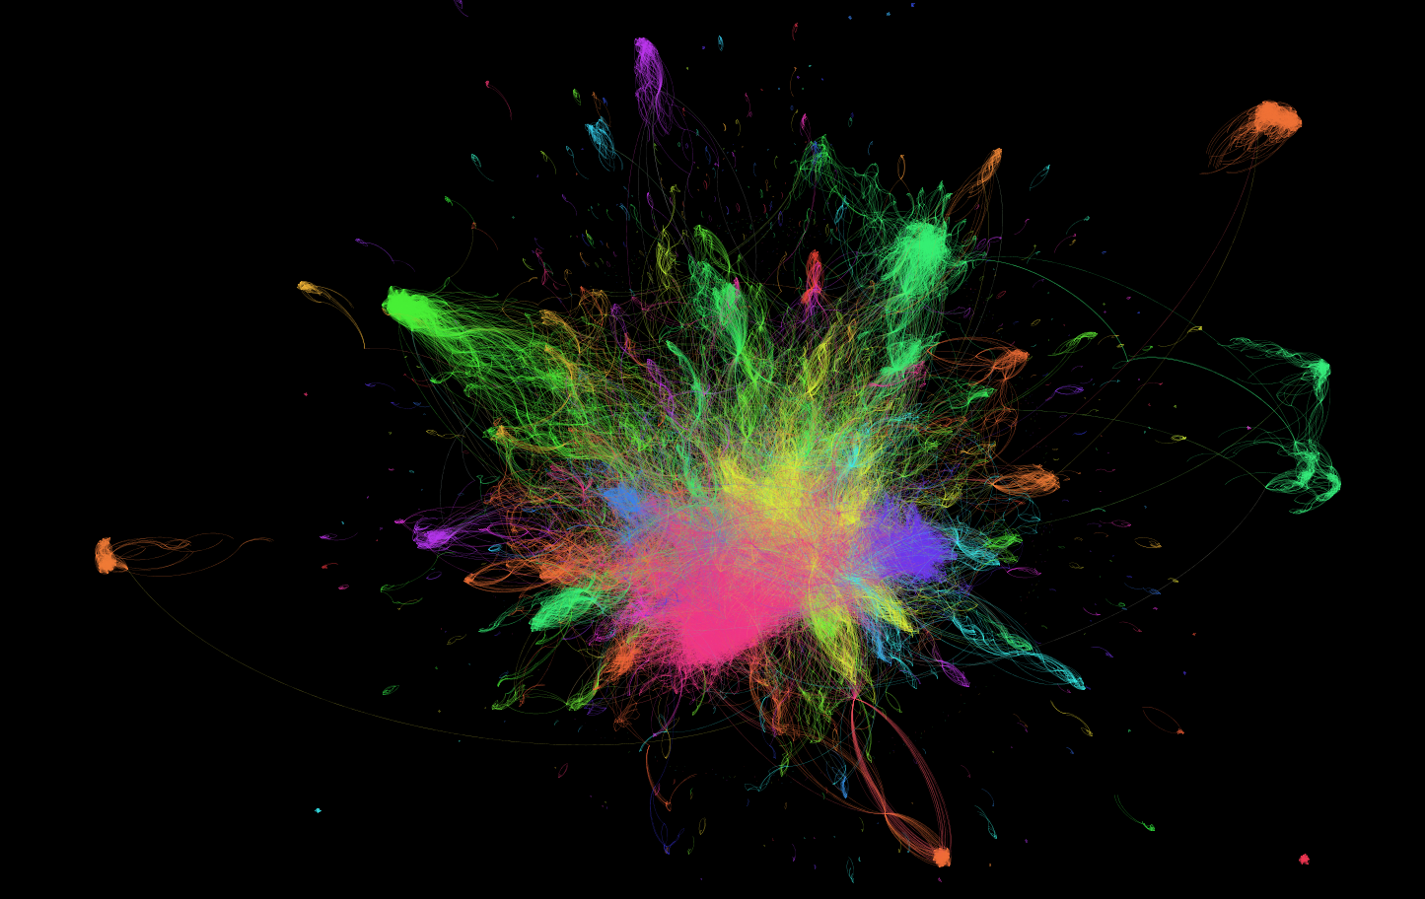
Big Data, Global Diplomacy, and our Digital Heartbeat
Kalev Leetaru
Yahoo! Fellow in Residence
Georgetown University
Kalev.leetaru5@gmail.com
http://www.kalevleetaru.com/

